Slide 1

How to add value to I.R.I.S. products combined or integrated into your favourite application
How to combine IRIS products
Available APIs
Examples of integrations
Ole Andersen
Senior Strategic Account Manager

Slide 2

IRISDocument
Server
All for One and One for All!
IRISCapture PRO

Slide 3



Short product description
IRISPowerscan™ is a powerful, user-friendly production application with a multi-stream architecture for the scanning and the electronic capture of any kind of documents. It is a complete professional solution to scan, structure, sort, index and convert all documents into fully searchable text files
IRISPdf Server™ is an advanced “production” OCR and compression solution that allows you to convert, index and compress volumes of scanned documents into electronic data and to supply any document management system with the appropriate file formats.
IRISCapture™ Pro is a very powerful applications for data extraction and sorting of all kinds of documents (Invoices, Forms, Cheques, Mail, CVs, ...)

Slide 4
Connect to backend applications
Event handler
Database connection
Central / custom installation

Slide 5
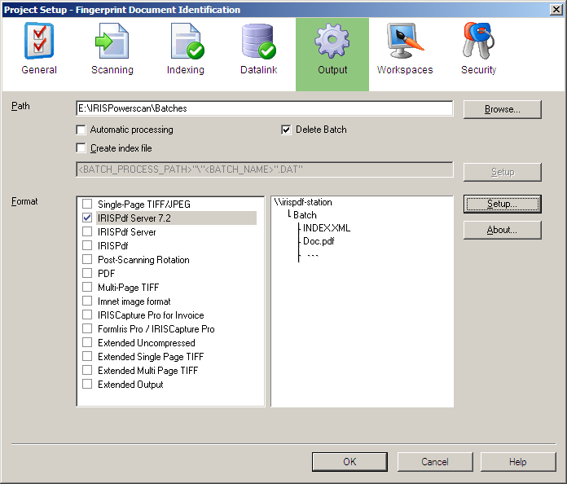
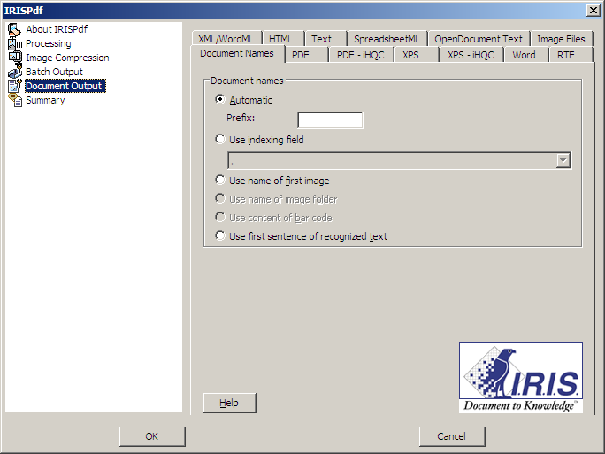
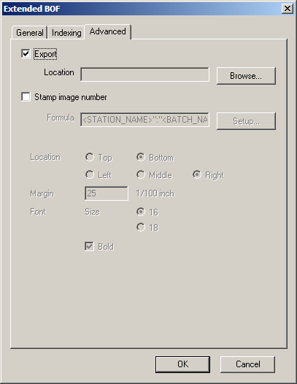
2 ways to connect IRISPowerscan to a backend application:
Create your own Batch Output Format:
Use export facility in the extended BOF:
Tips: You can use Batch Output Formats from Kodak Capture Software with some minor adjustments !

Slide 6
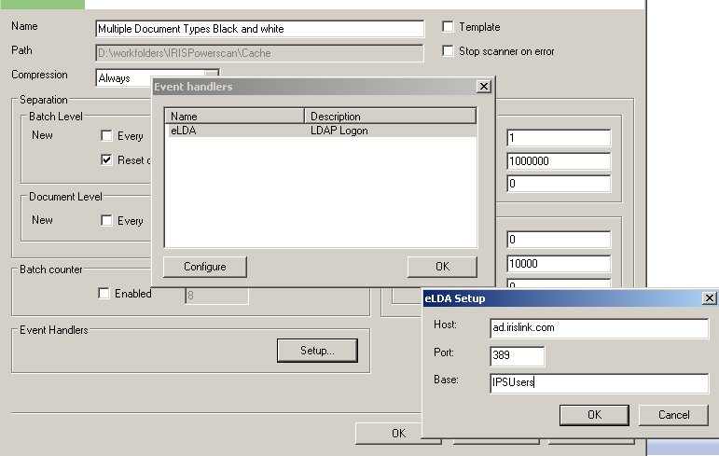
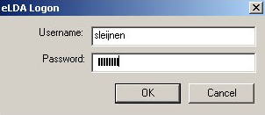
Event handler – authenticating users through active directory

Slide 7
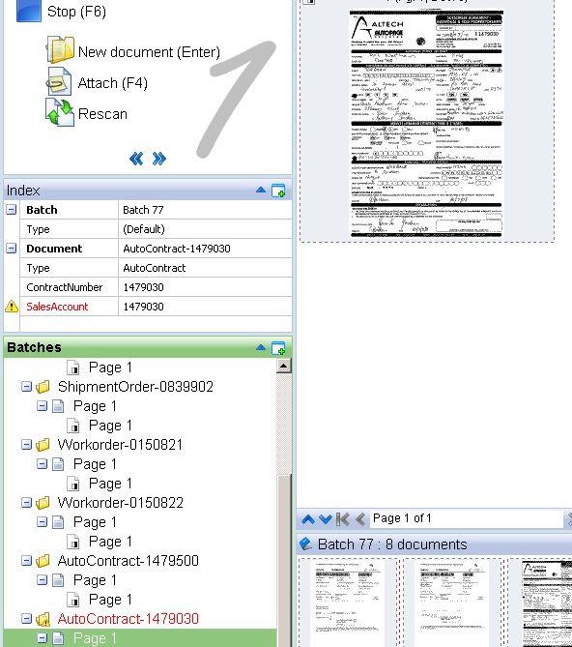
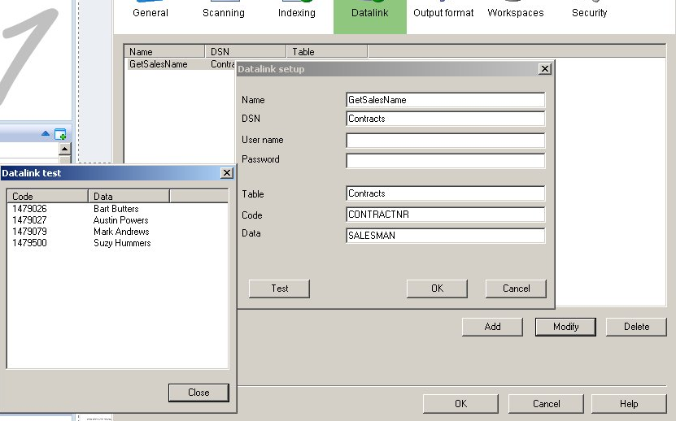
Database connection – Contract number will be read on the document to get the name of the responsible salesman from the db

Slide 8
Central installation
You can install all projects and IPS config files on a central server. When the IPS clients notice a change in the central setup they will update their own config file
Custom installation
You can easily modify and or add components to the installer package
This means that you can customize the installation package needed for your clients scanning stations

Slide 9
Export API
Command line integration
detailed.xml

Slide 10
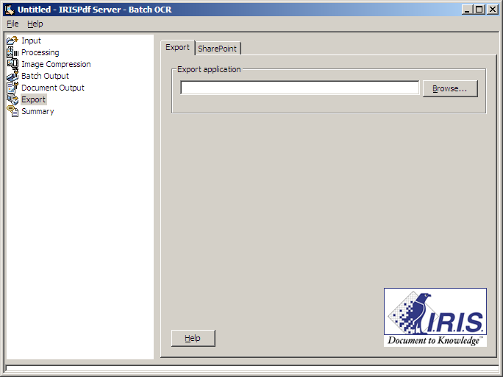
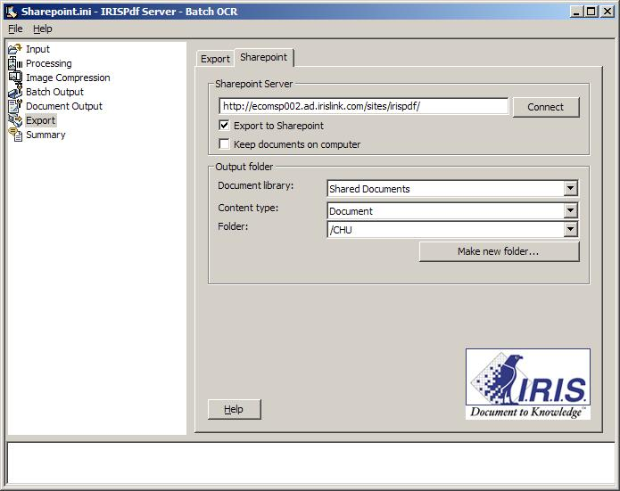
Export API
  Export files and indexes to any application or document management system
TIPS: Create a BOF for IRISPowerscan 9.0 and this BOF can later be used with IRISDocument Server 10.0 as a standalone solution

Slide 11
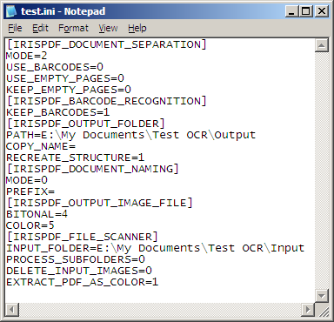
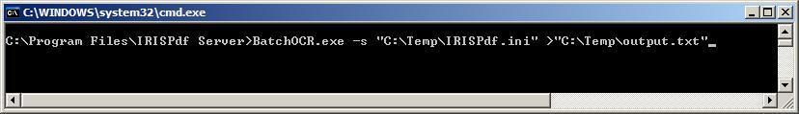
Command line integration
Call the “C:\Program Files\IRISPdf Server\BatchOCR.exe” from the command line (DOS) with the arguments:
  “-s” to run in silent mode
  INI settings file created with BatchOCR through the interface
  Optional: add behind an output file to collect the output stream of BatchOCR
Example : “BatchOCR.exe –s “C:\Temp\IRISPdf.ini” >“C:\Temp\output.txt”
This allows you to integrate IRISPdf into your application if you wish. The user will not see the IRISPdf interface and you will be able to track the processing.

Slide 12
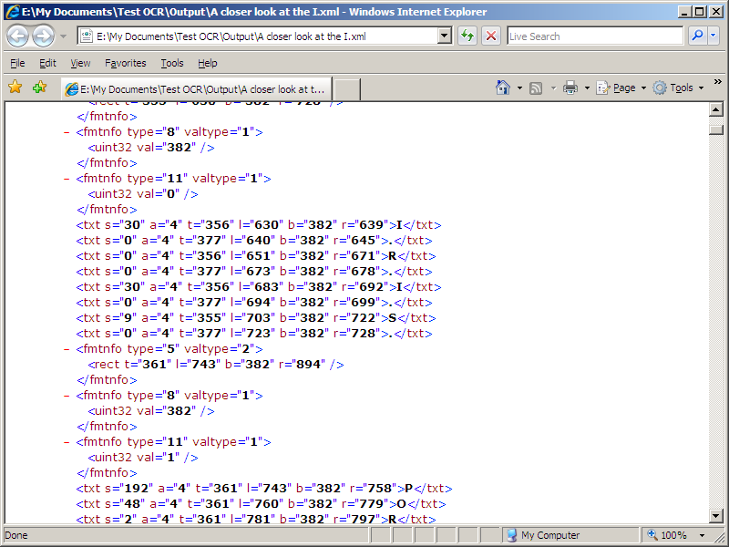
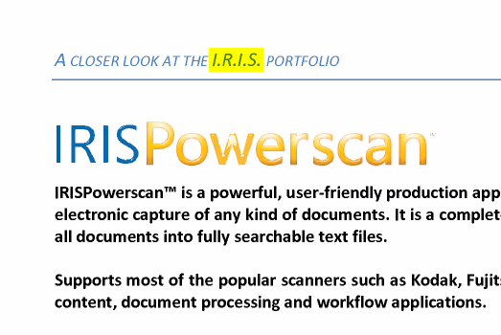
detailed.XML
- contains information about position, font type and confidence level

Slide 13
Integration APIs
Customise the workflow
Scripting per field
ICP Studio
ClientICP

Slide 14
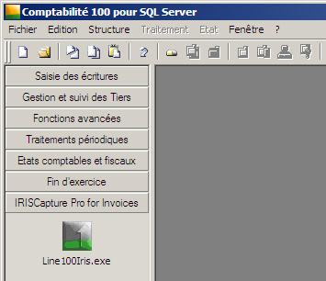
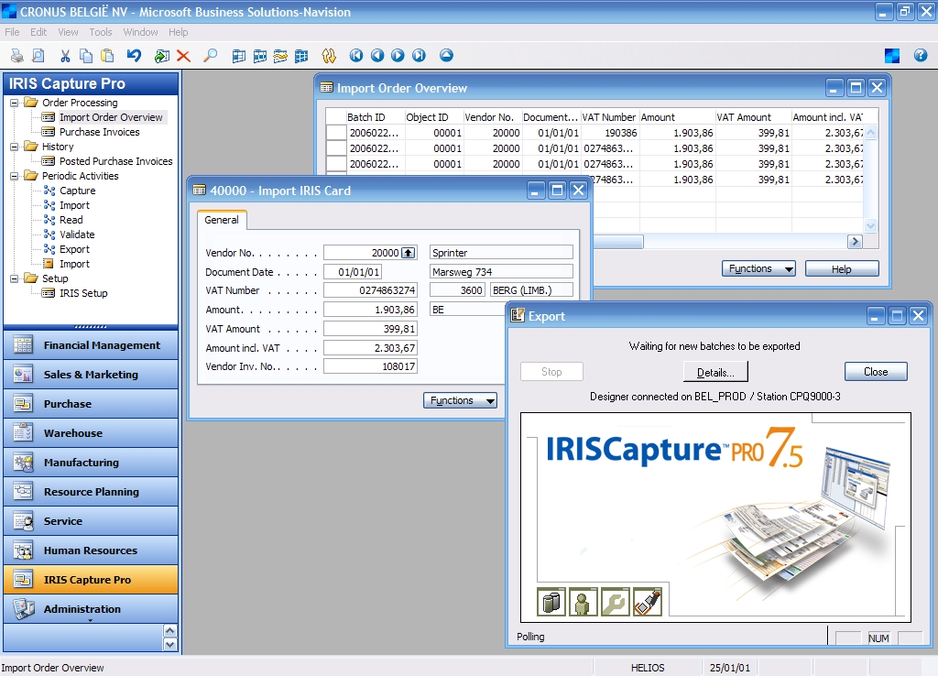
API available to integrate into another application

Slide 15
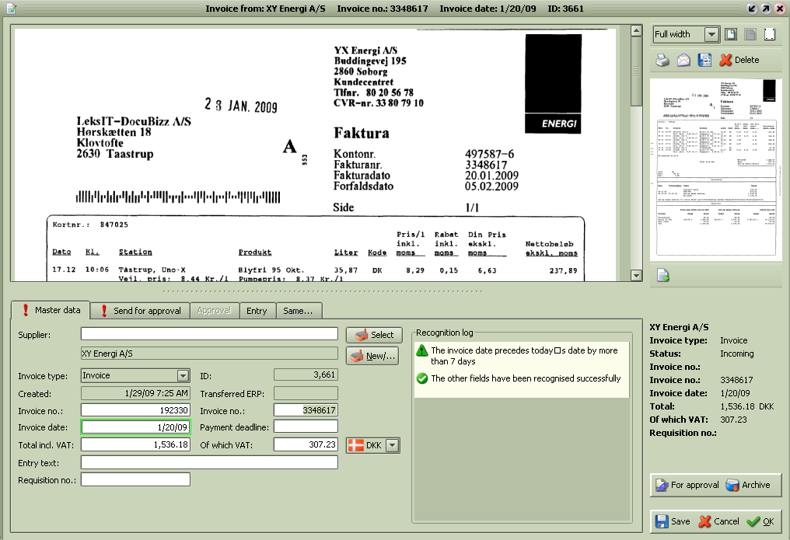
Service mode, XML file parsing and field status

Slide 16
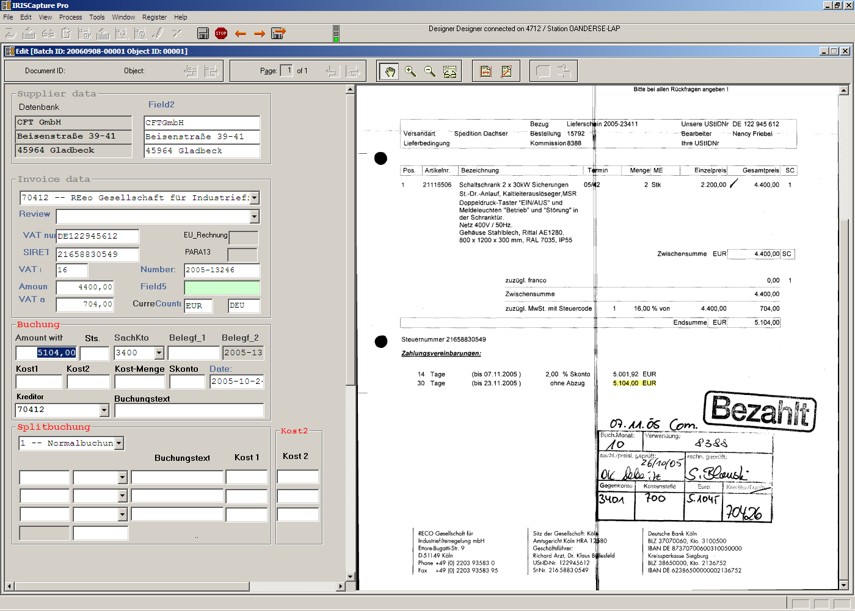
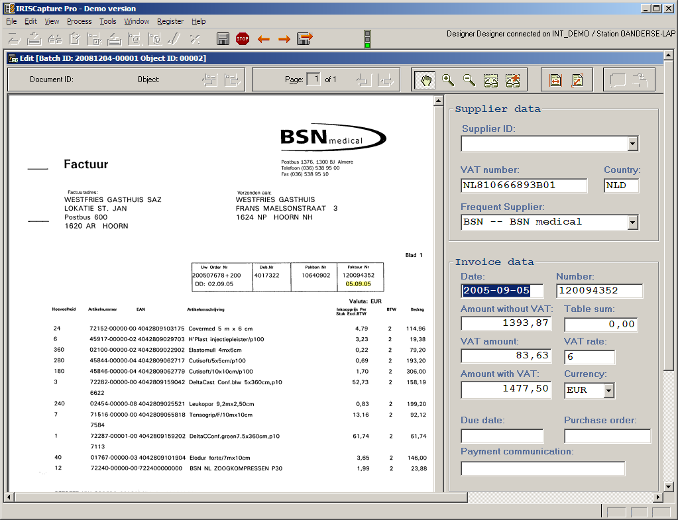
Customising a database by using ICP Studio and javascripts

Slide 17
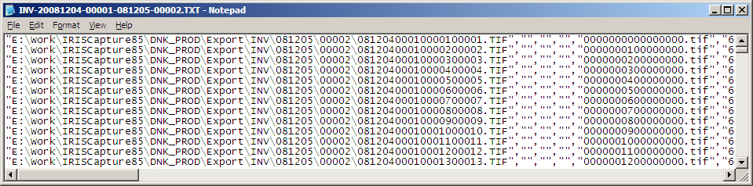
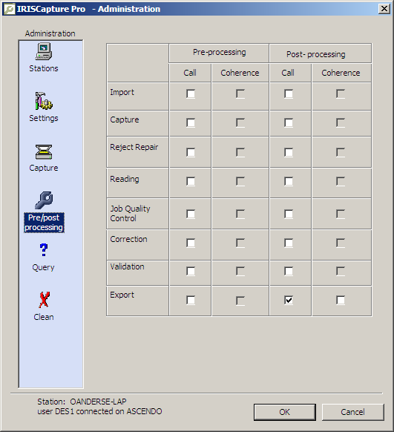
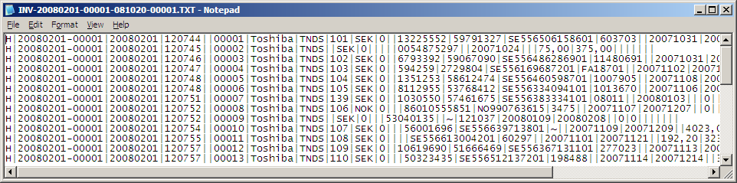
Launch your own processes within the workflow of IRISCapture

Slide 18
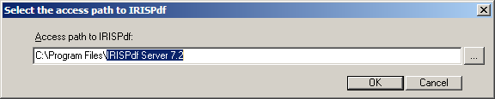
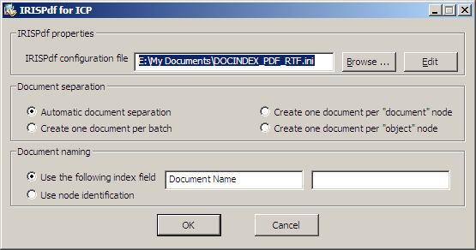
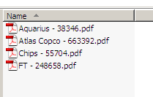
Connecting IRISCapture with Document Server

Slide 19
Conclusions
IRIS products give you full flexibility to create customised solutions by
  Interconnecting IRIS products
  Connecting IRIS products to other applications through numerous methods
  Integrating IRIS products into other applications
  Modifying the behaviour of IRIS products thanks to APIs
  Adding functionality to IRIS products through one of it’s APIs
IRIS have presales engineers that can help you ☺

Slide 20
Thank you!

